Slide 1
Chapter 2: Stress and Strain-Axial Loading
Problem No: 2.33-2.38, 2.47-2.51, 2.61-2.64, 2.75-2.82

Slide 2
List of topics today
Statically indeterminate problems
Composite structures
Thermal stresses
Poisson’s Ratio
Shearing Strain

Slide 3
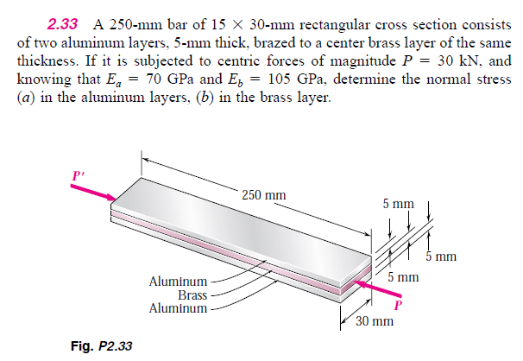

Slide 4
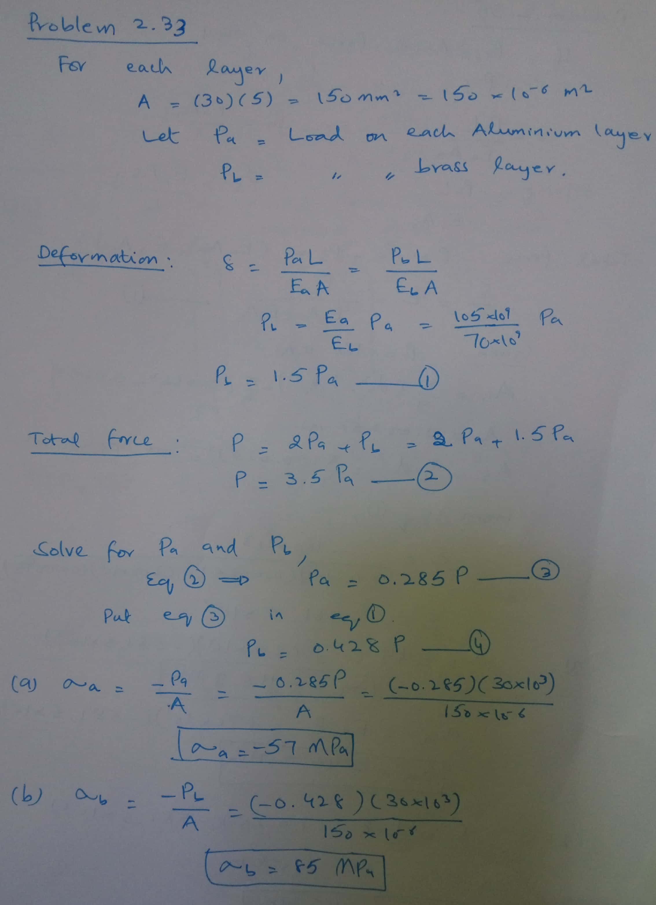

Slide 5
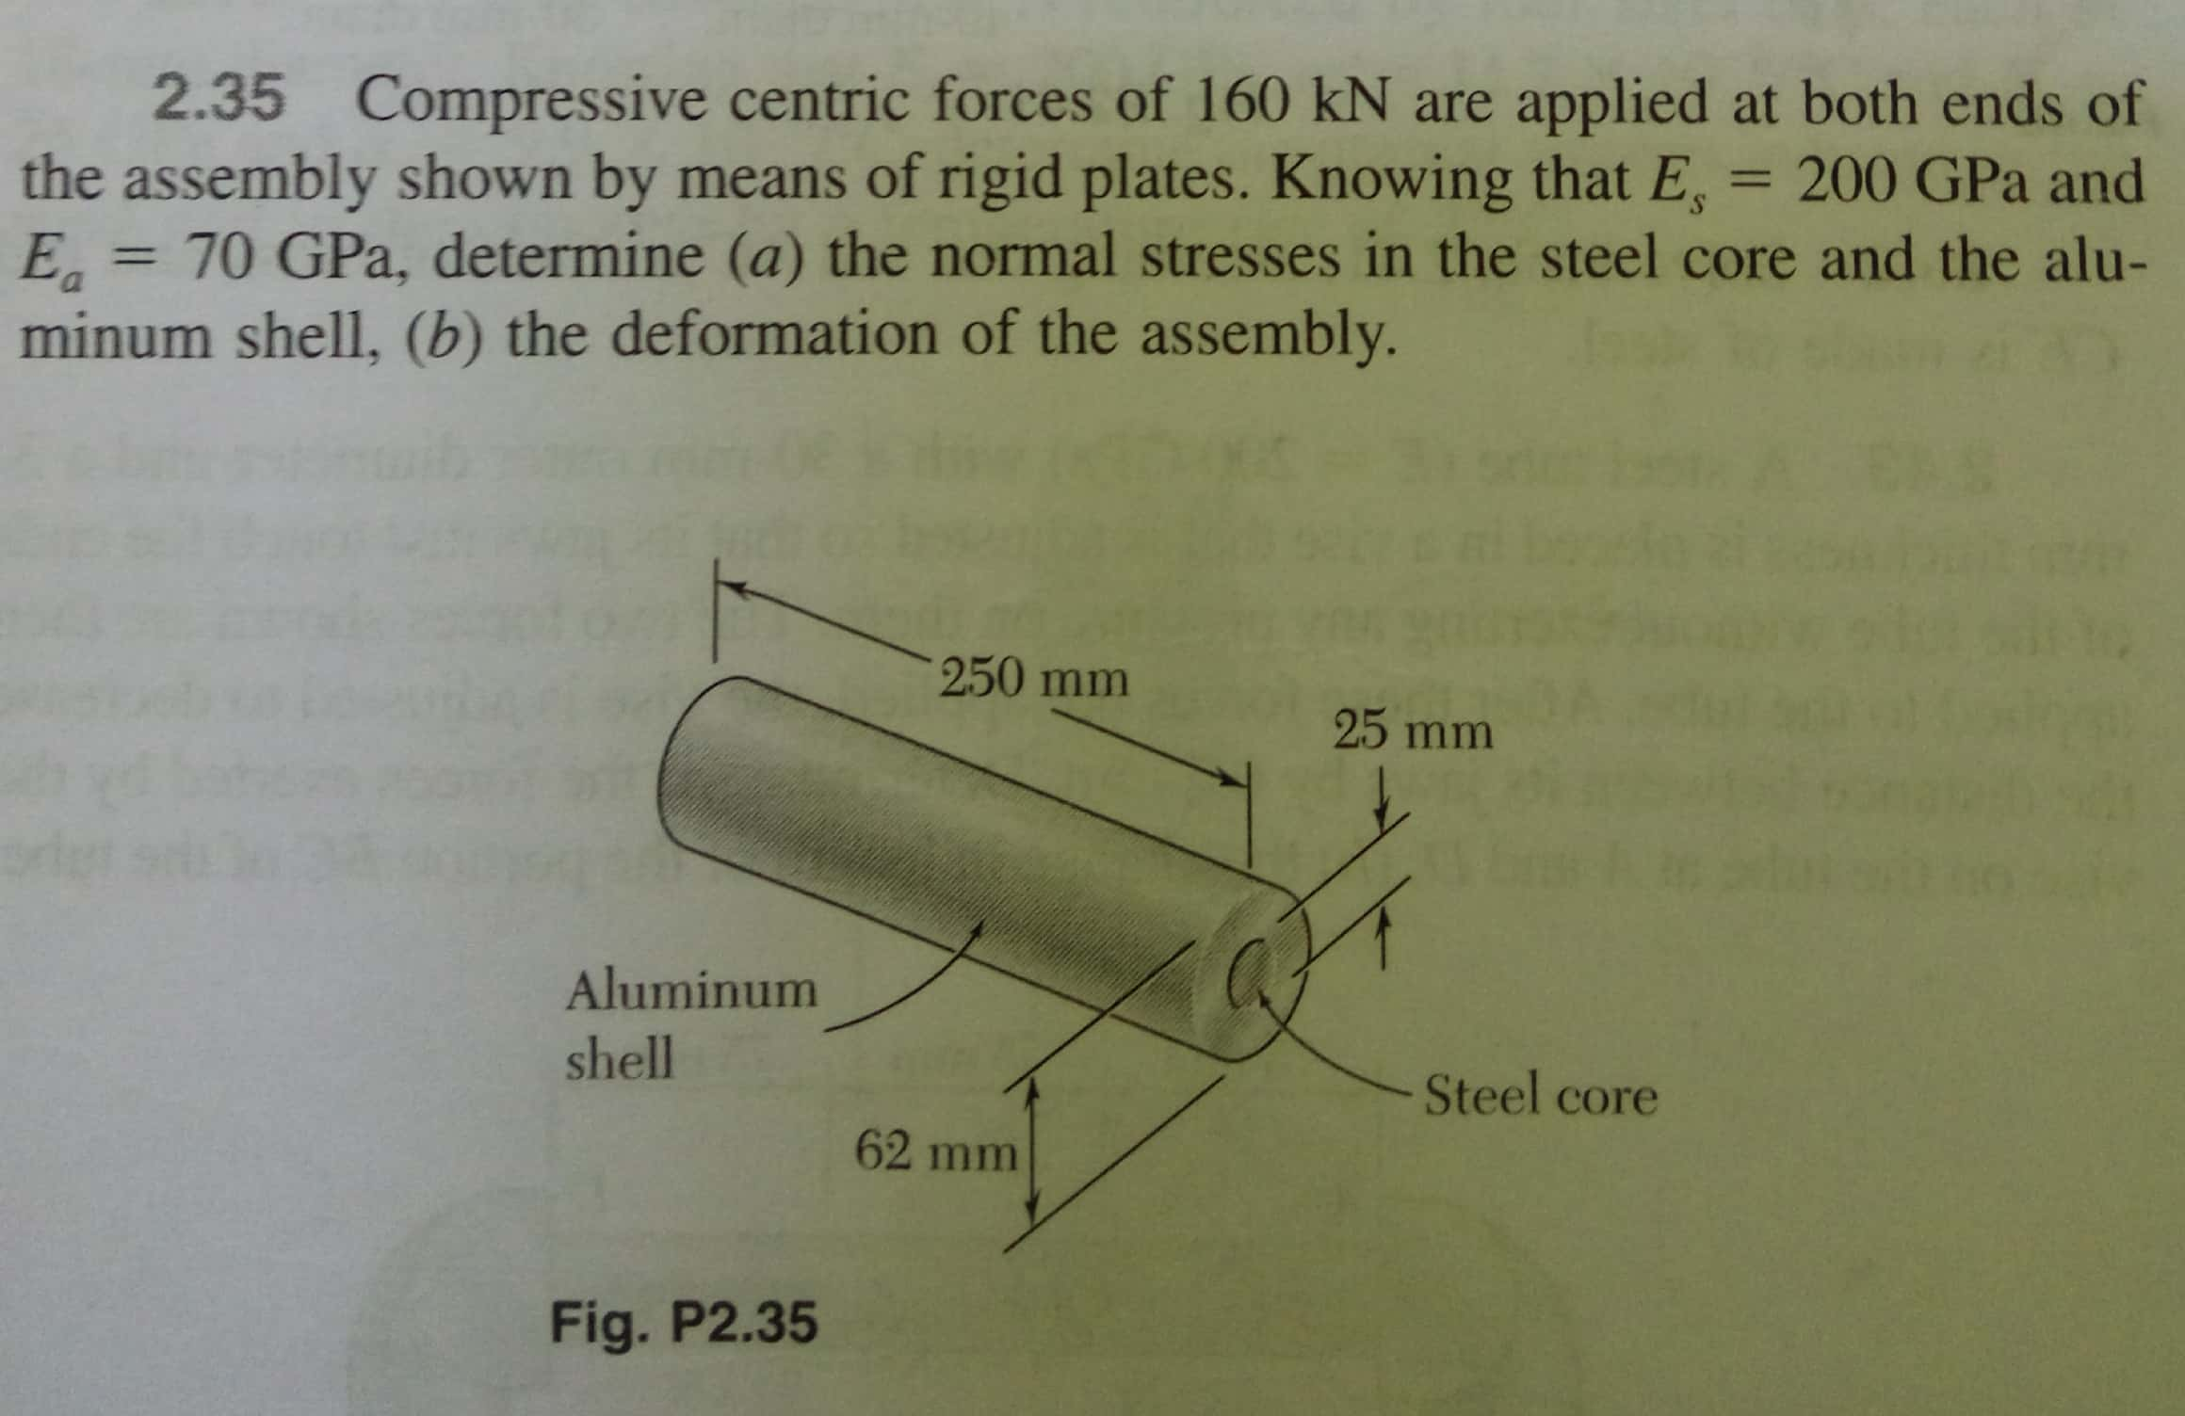

Slide 6
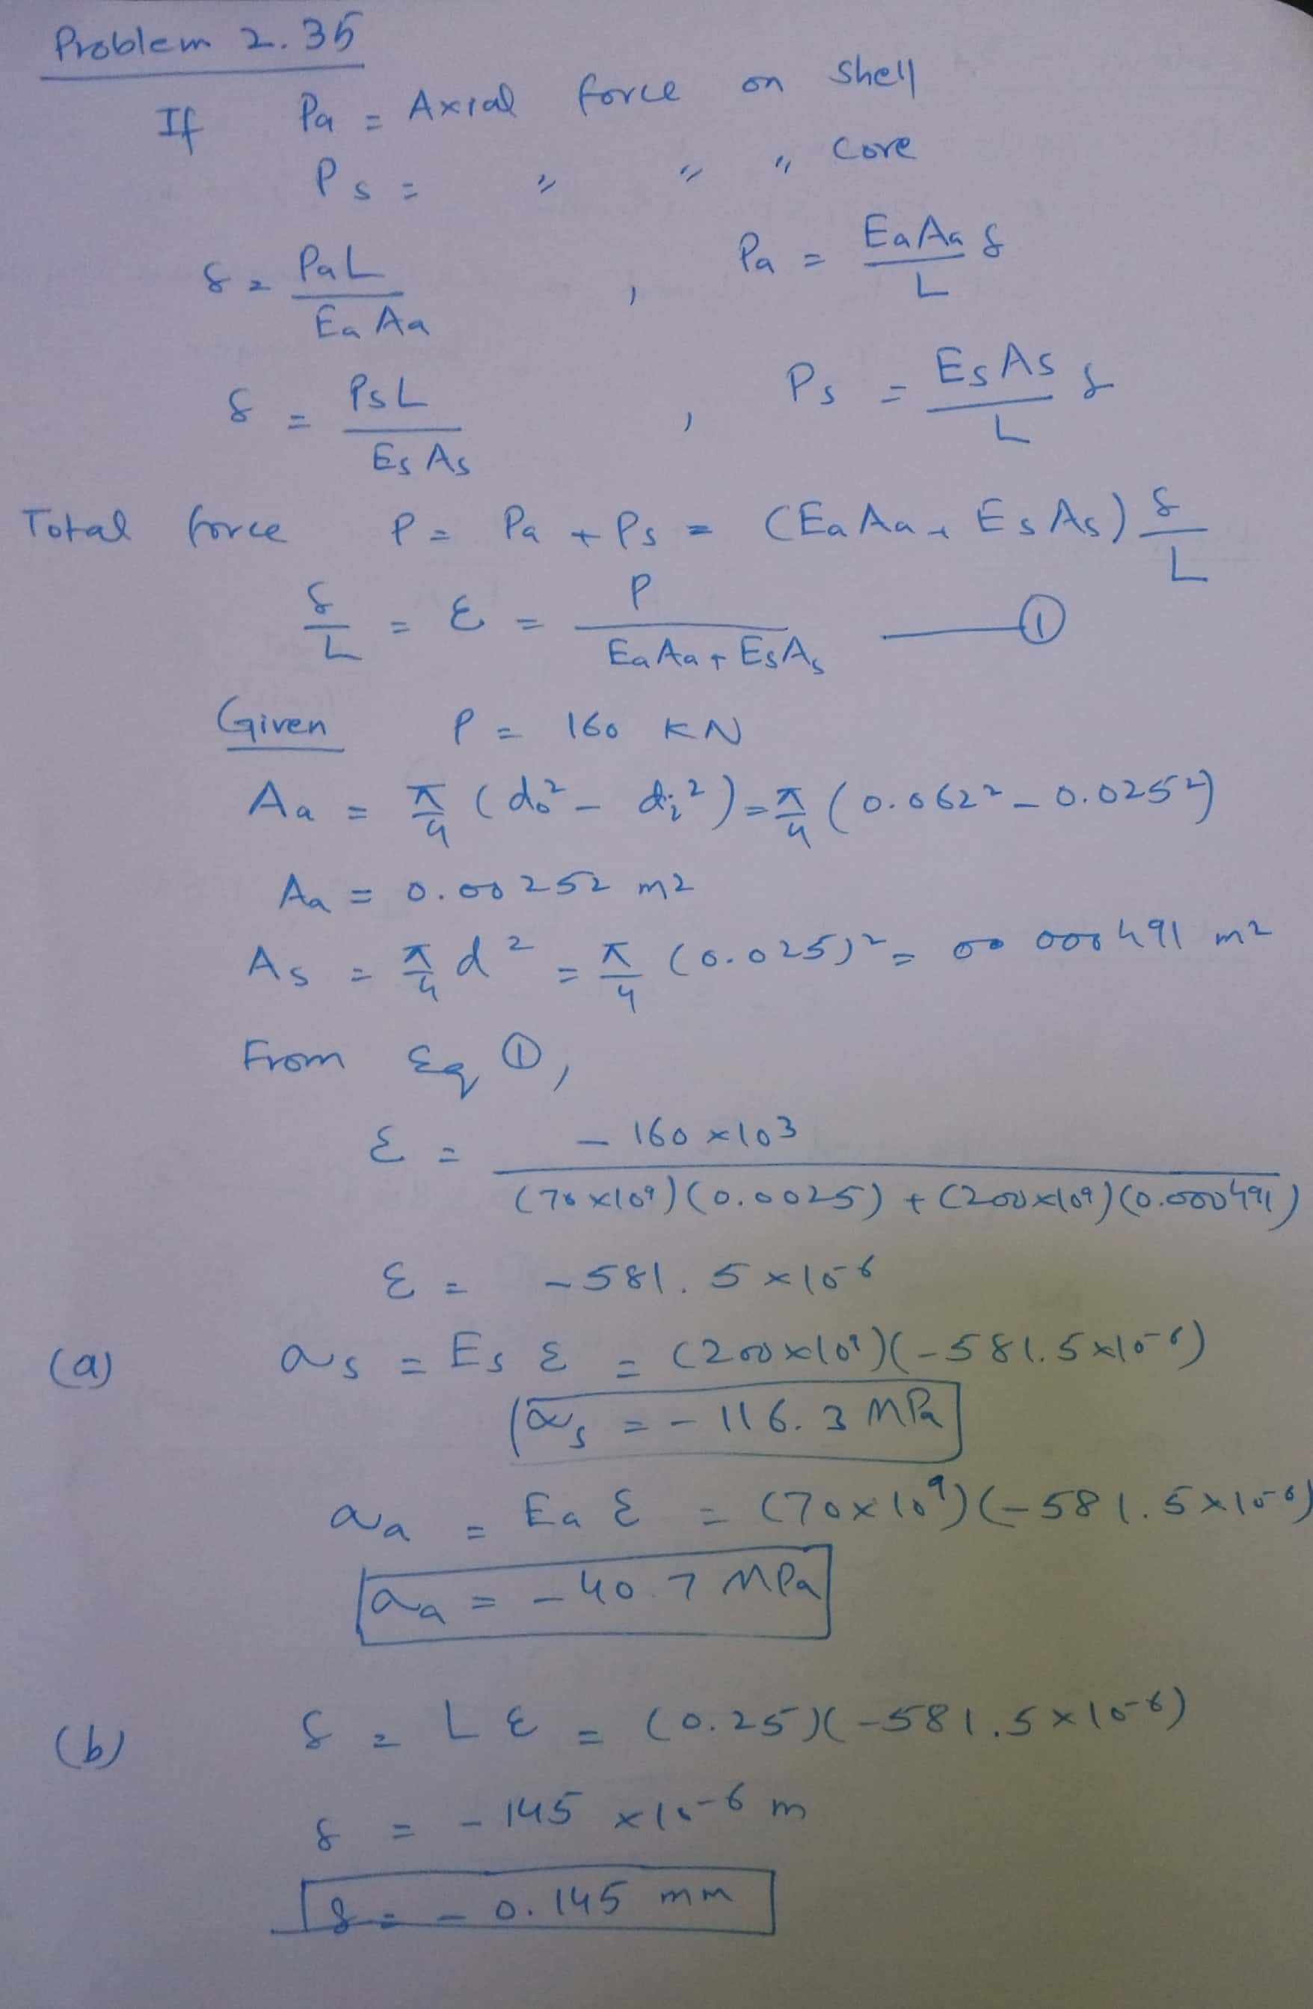

Slide 7
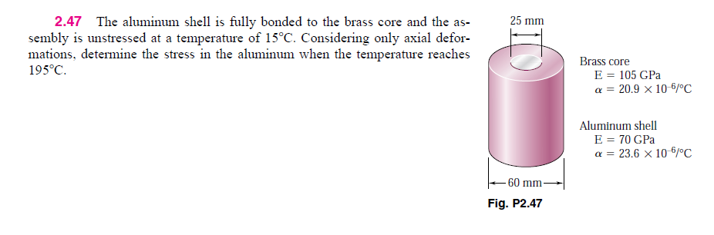

Slide 8
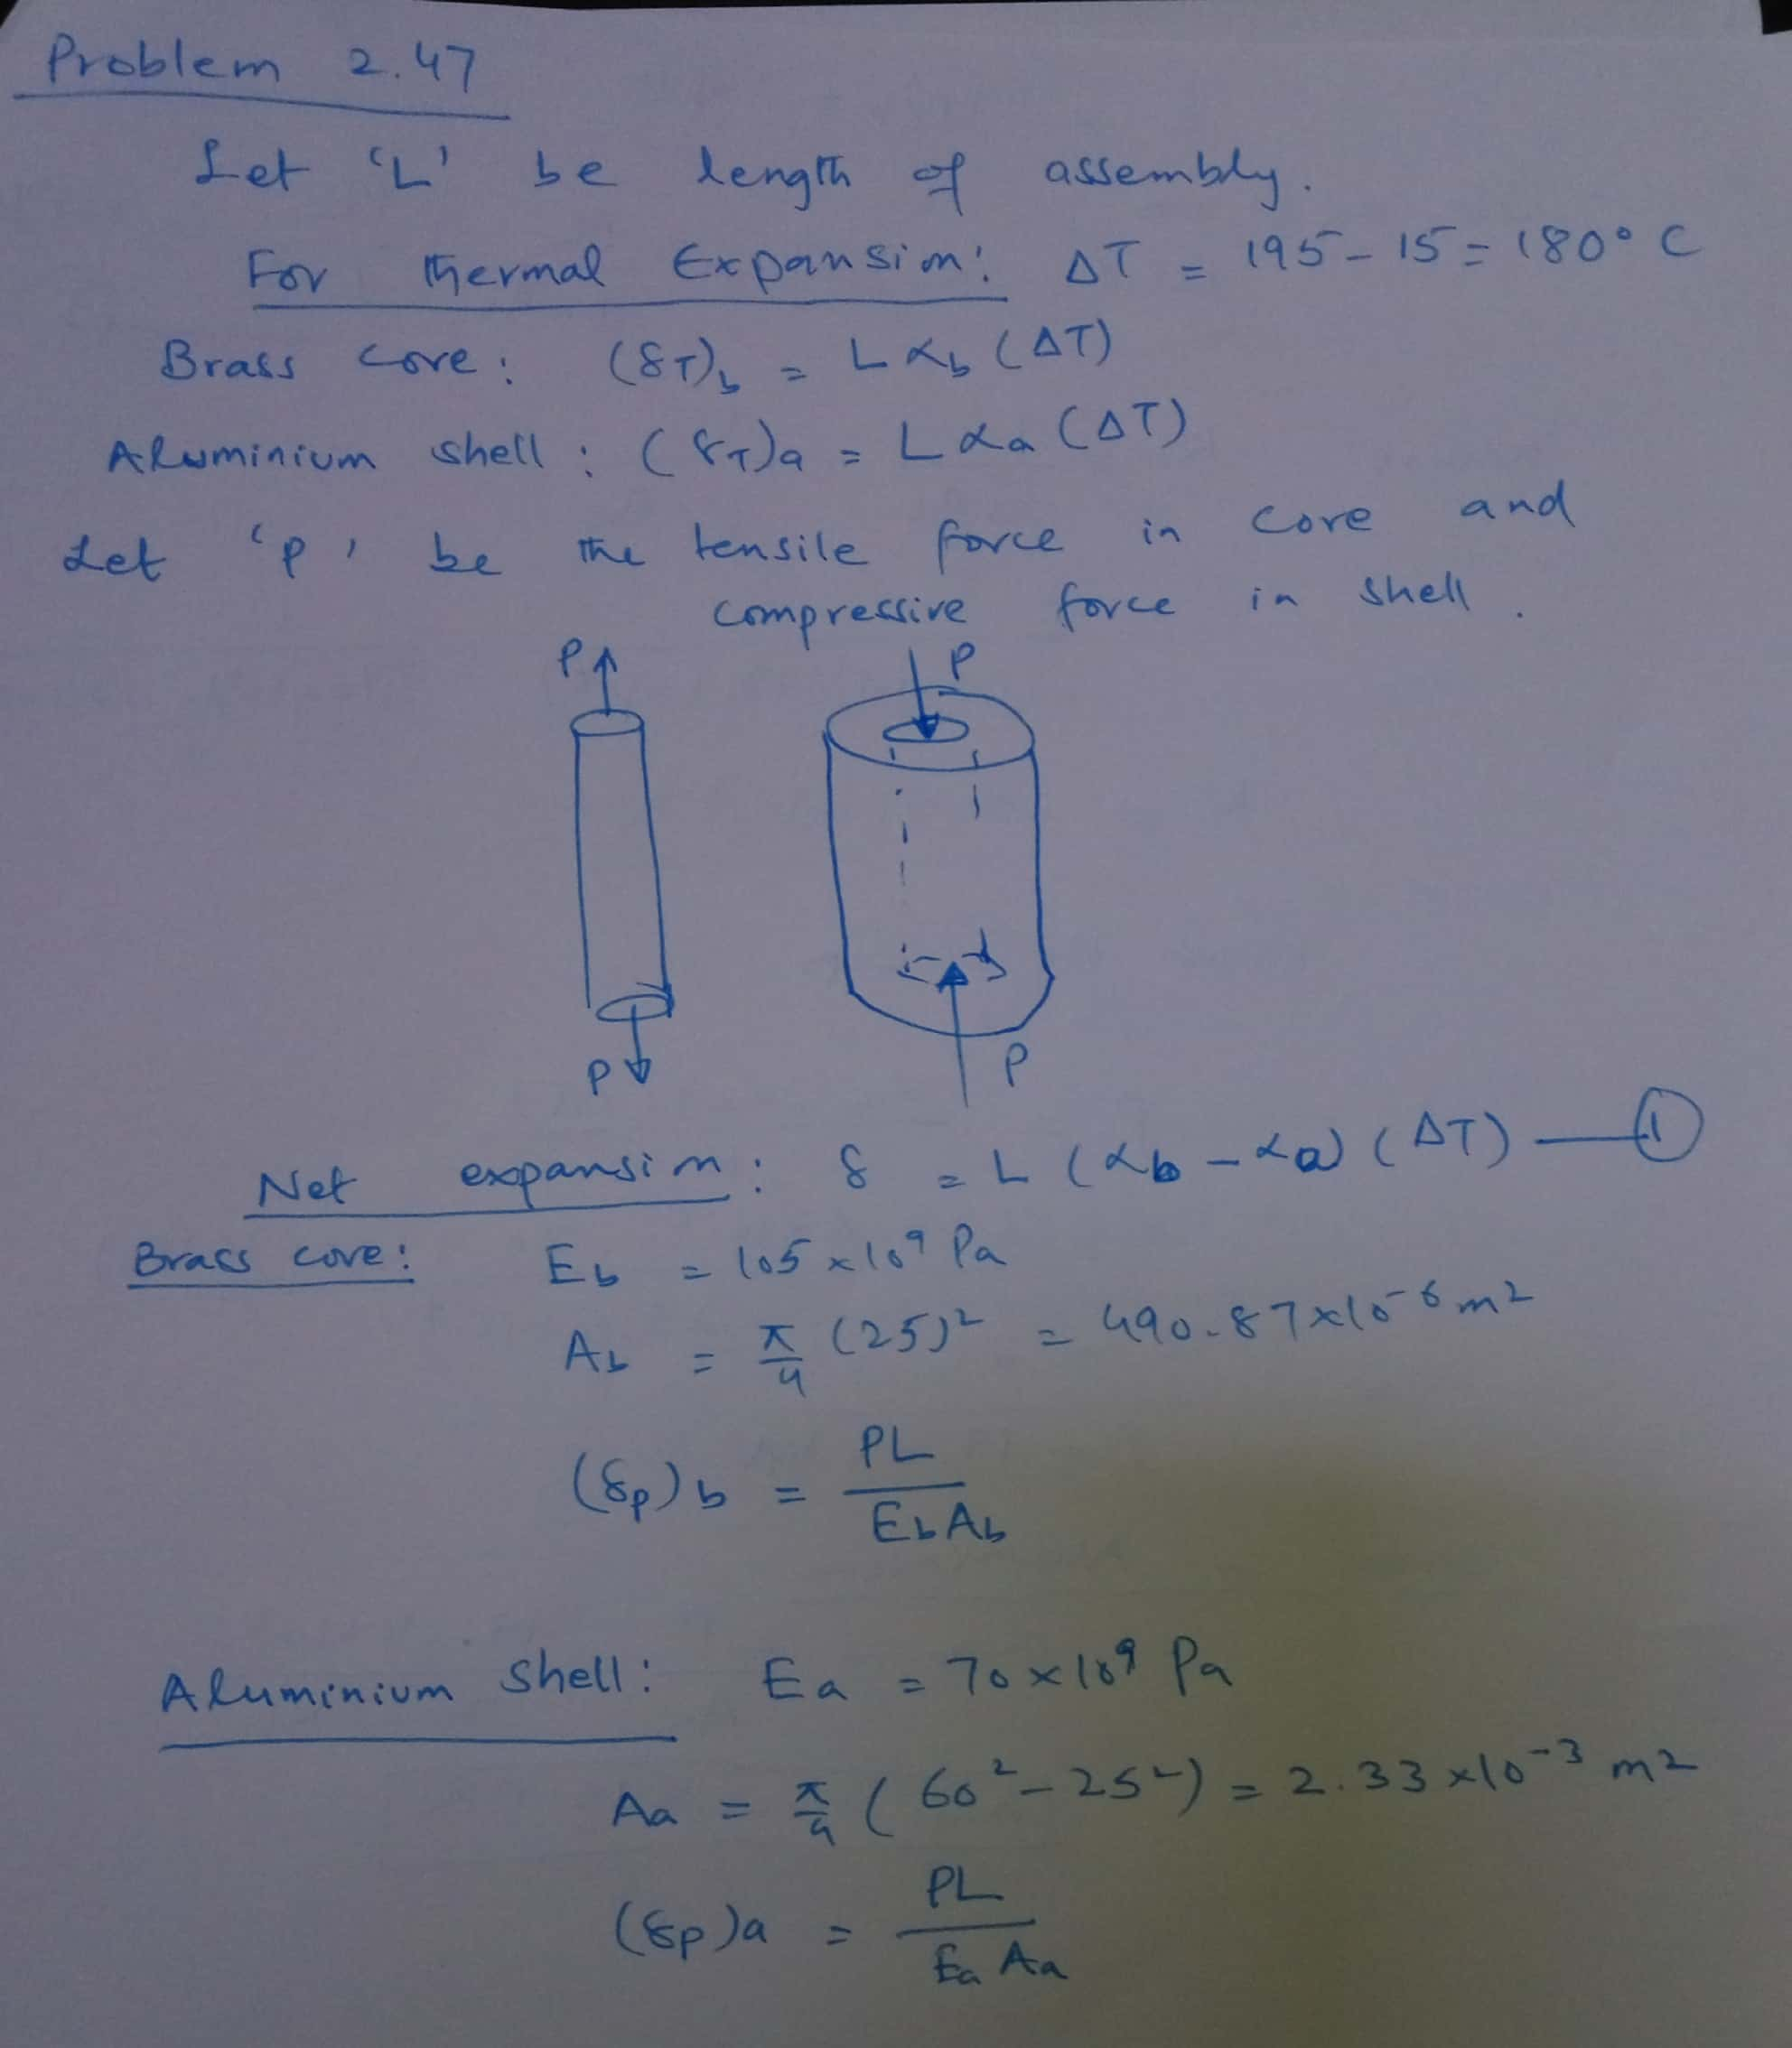

Slide 9
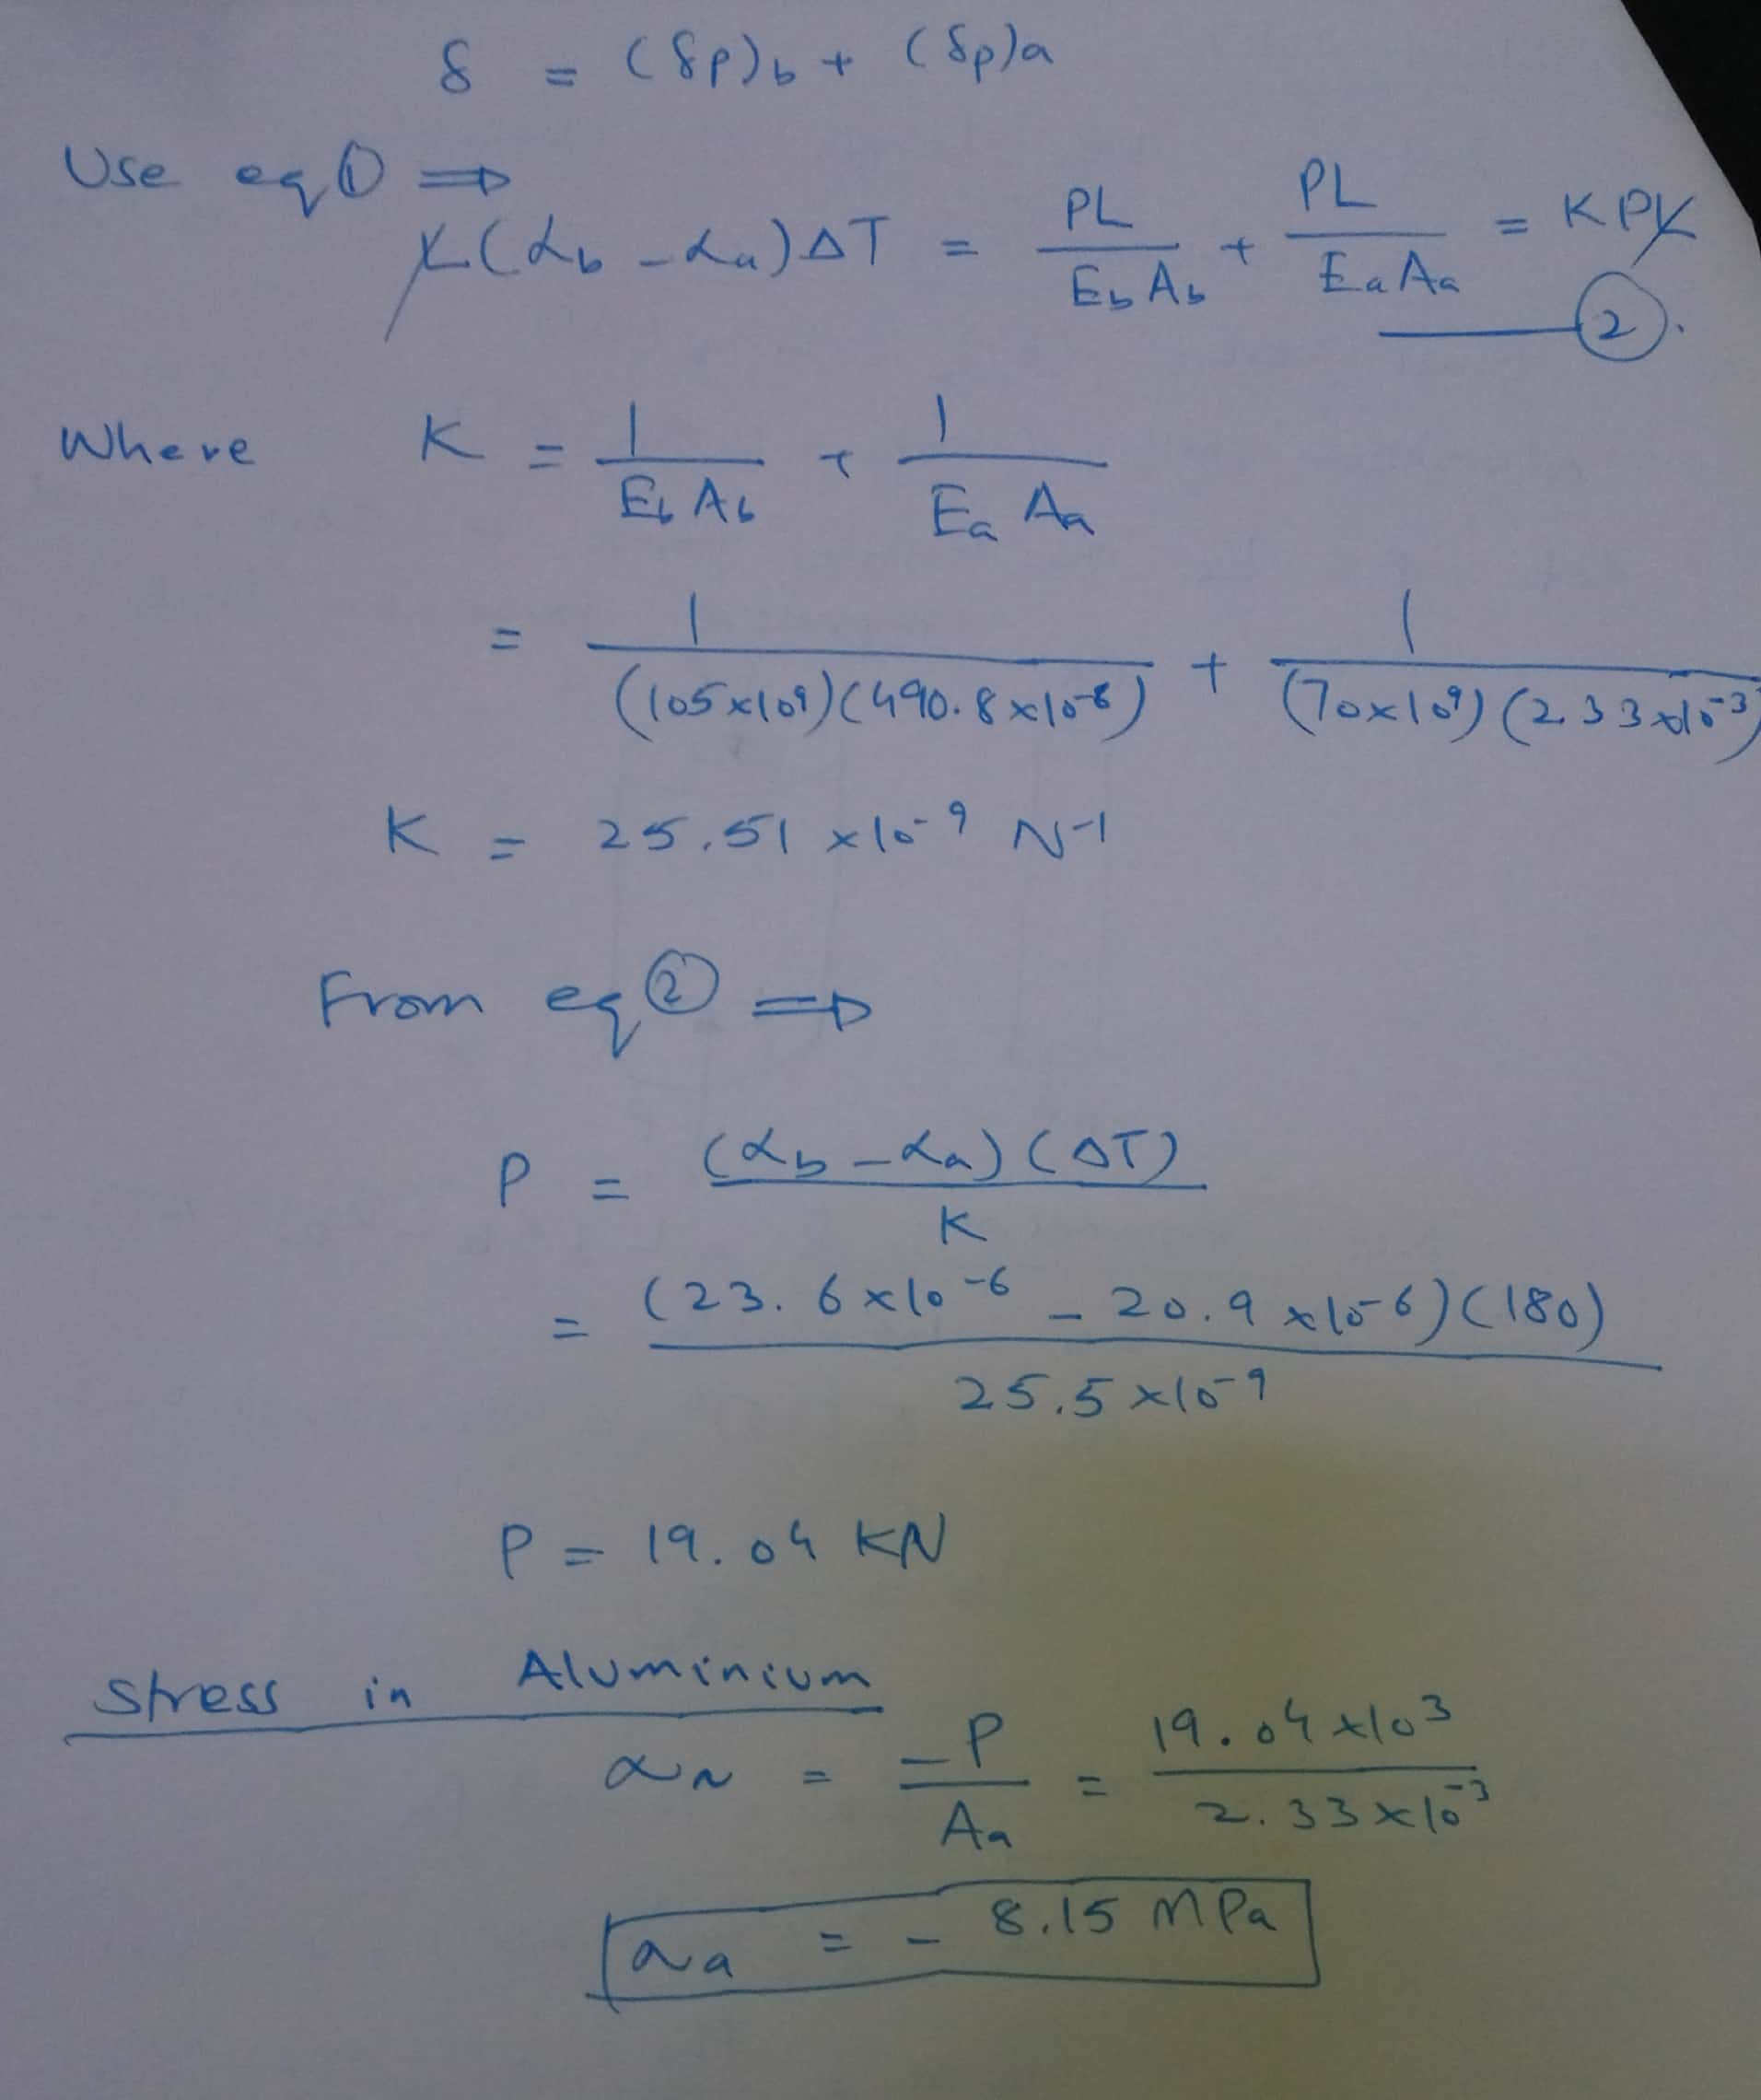

Slide 10
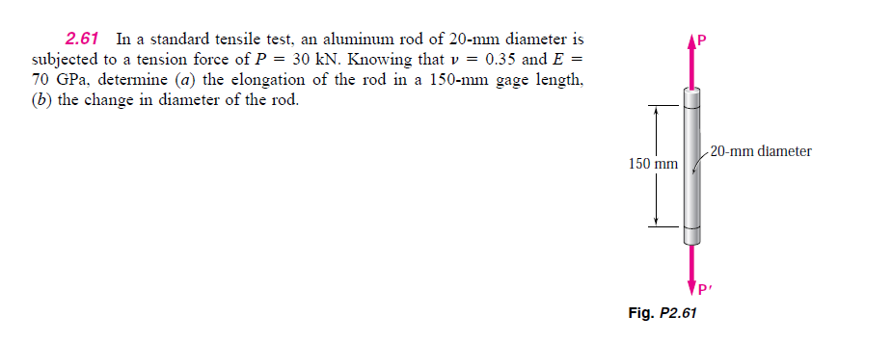

Slide 11
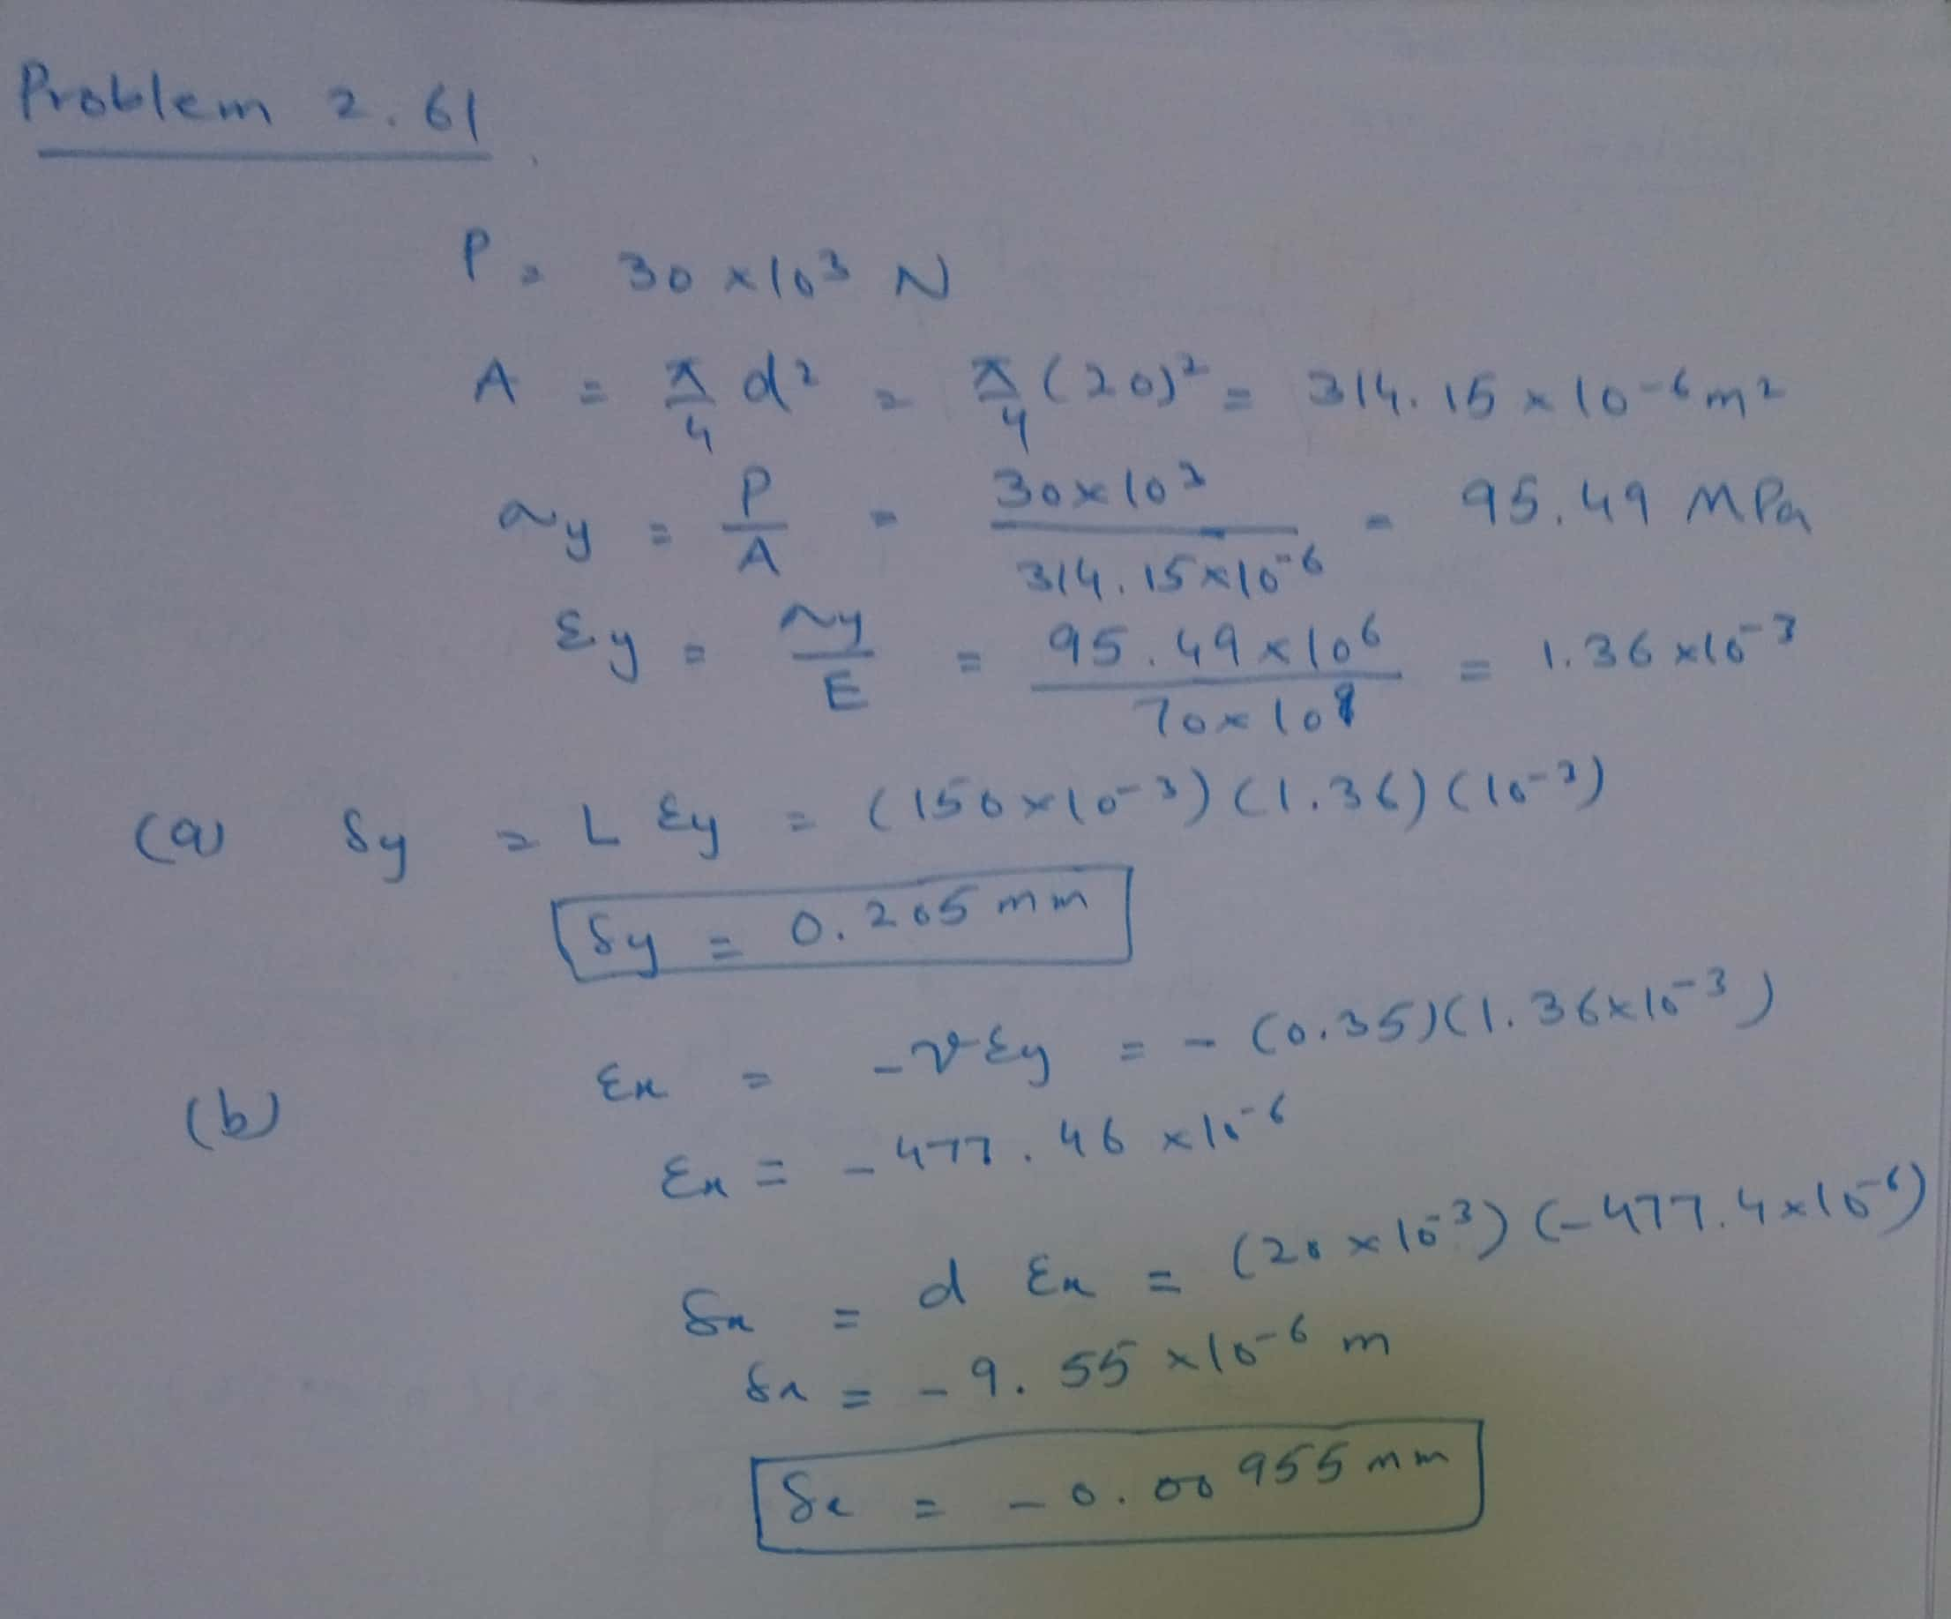

Slide 12
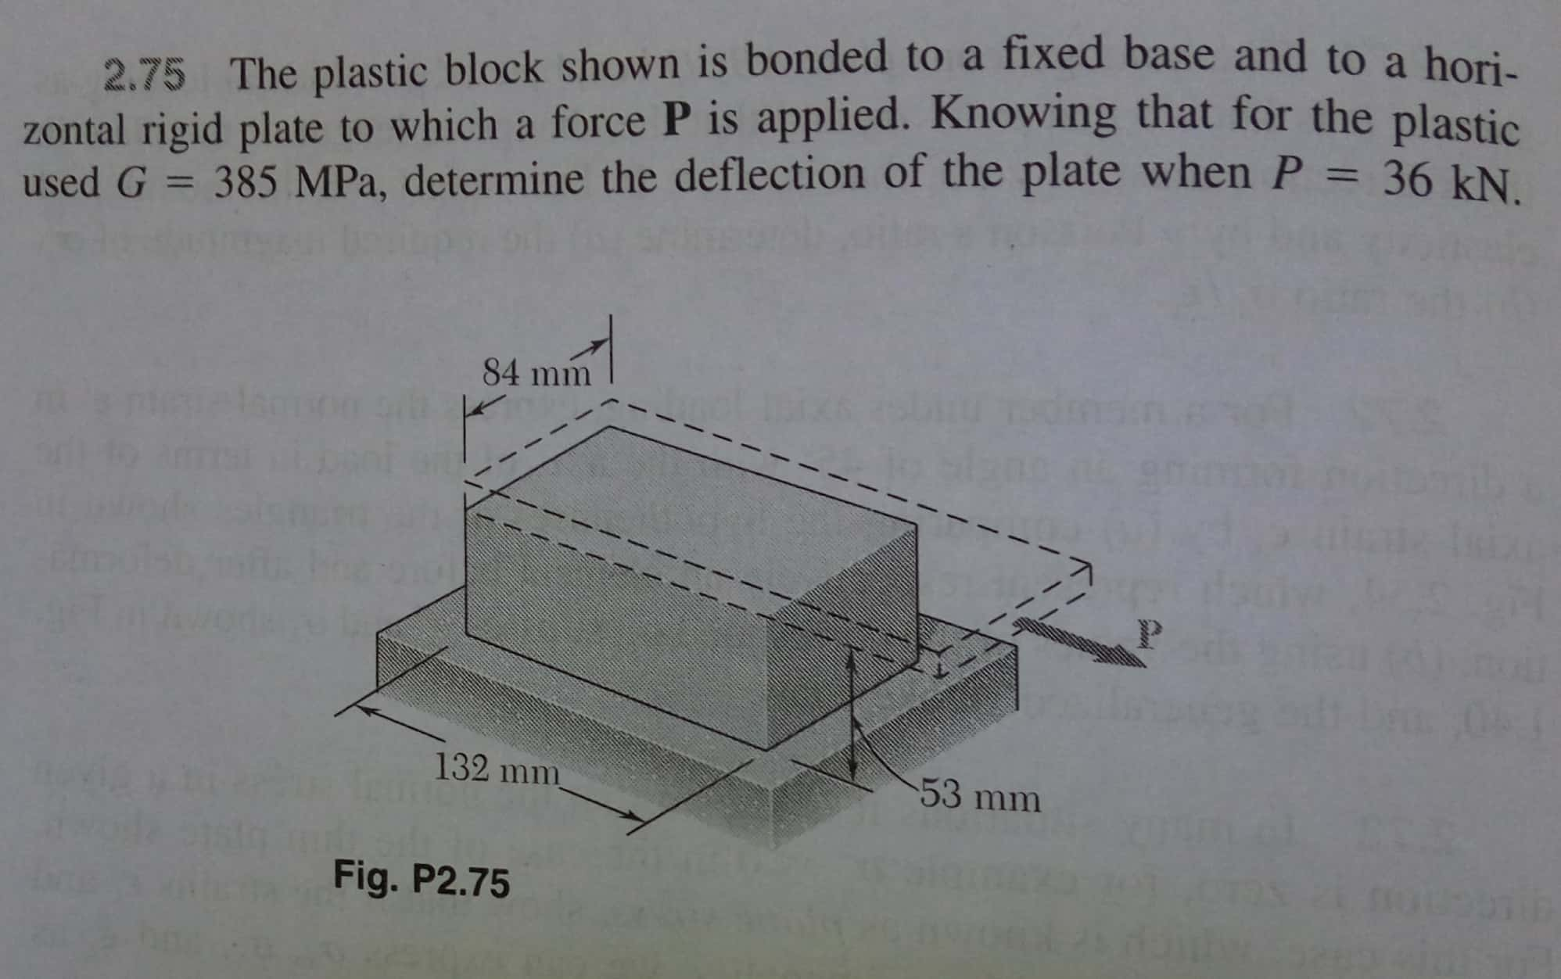

Slide 13
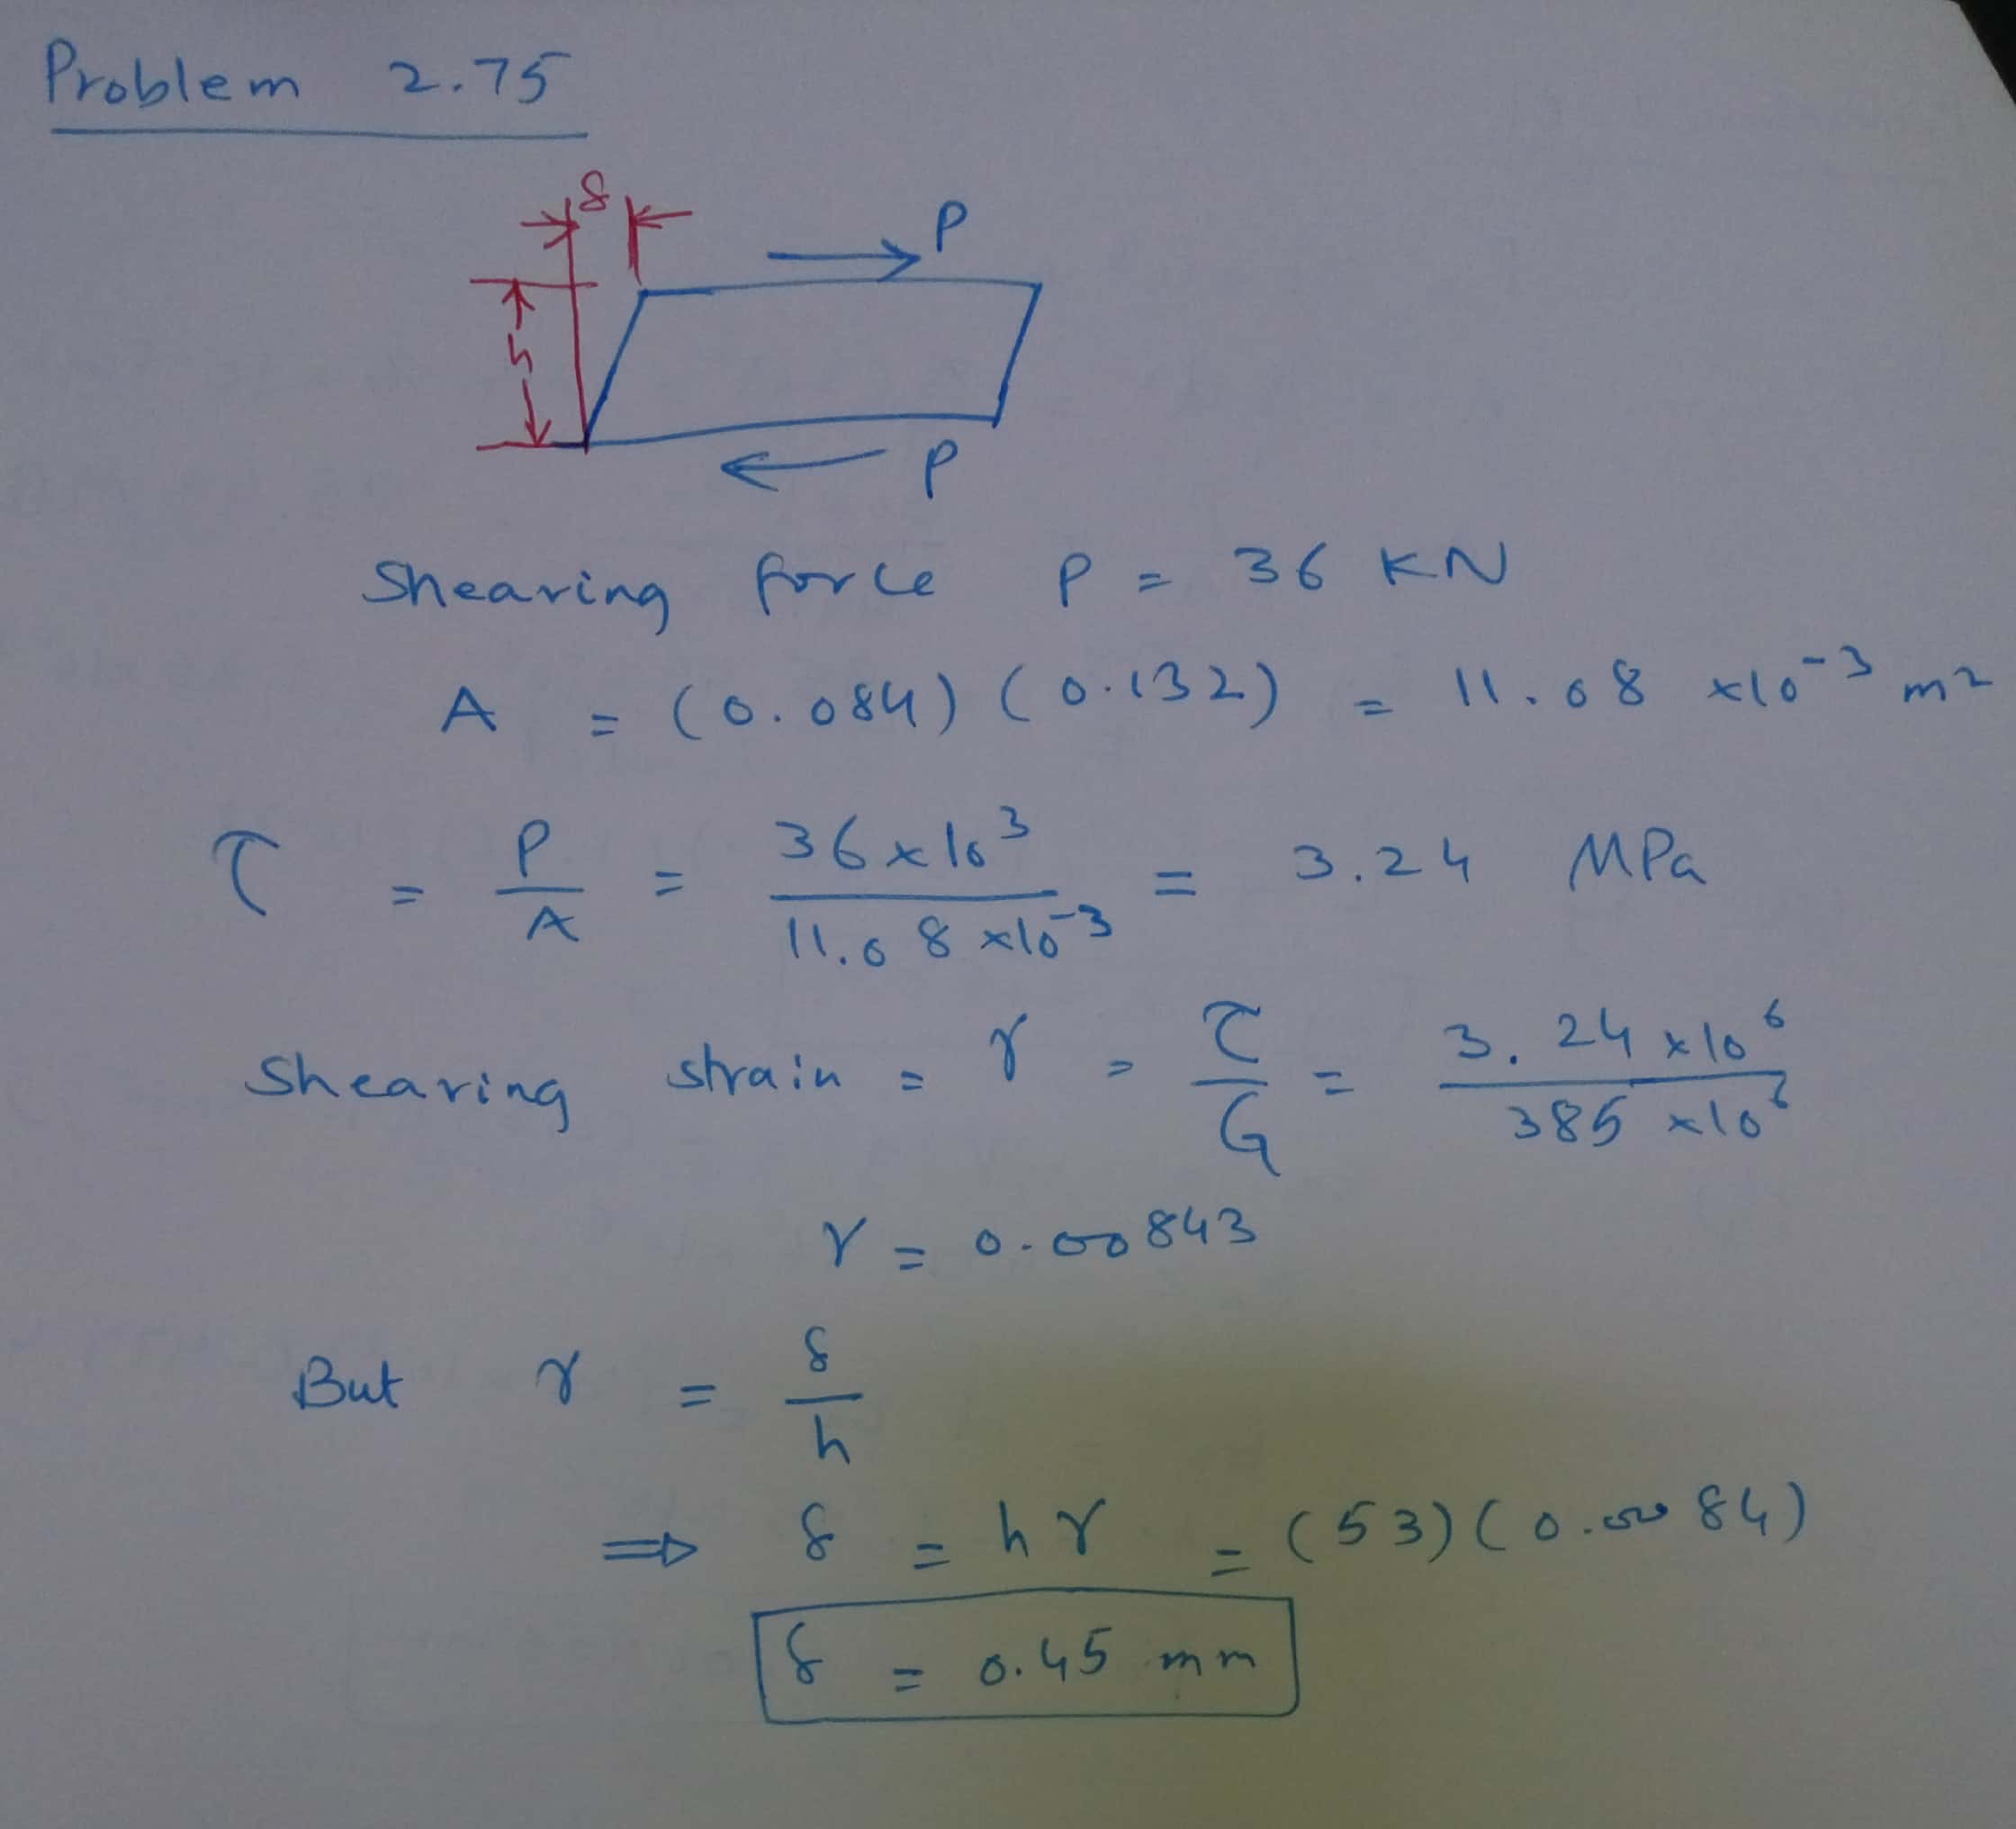

Slide 14
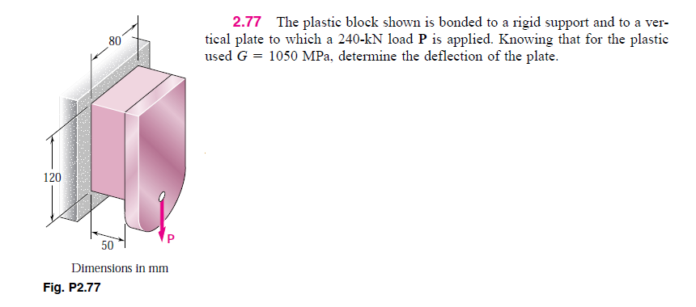

Slide 15
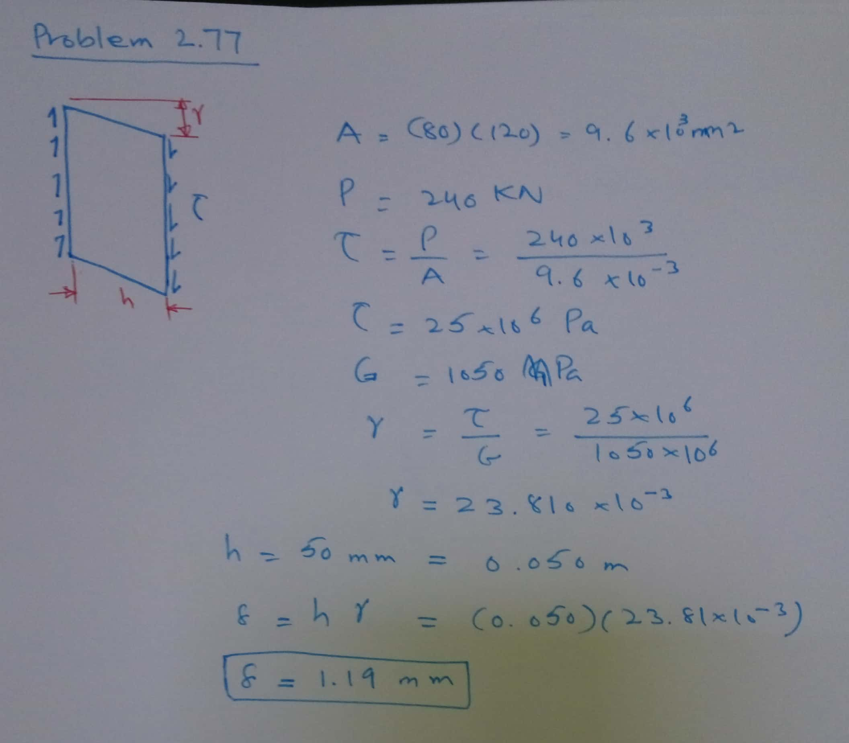

Slide 16
Assignment 1
1.1-1.9, 1.13, 1.15, 1.28, 1.29-1.39, 1.42-1.46
2.1-2.20, 2.21-2.23, 2.25-2.28, 2.33-2.38, 2.47-2.51, 2.61-2.64, 2.75-2.82

